Slide 1
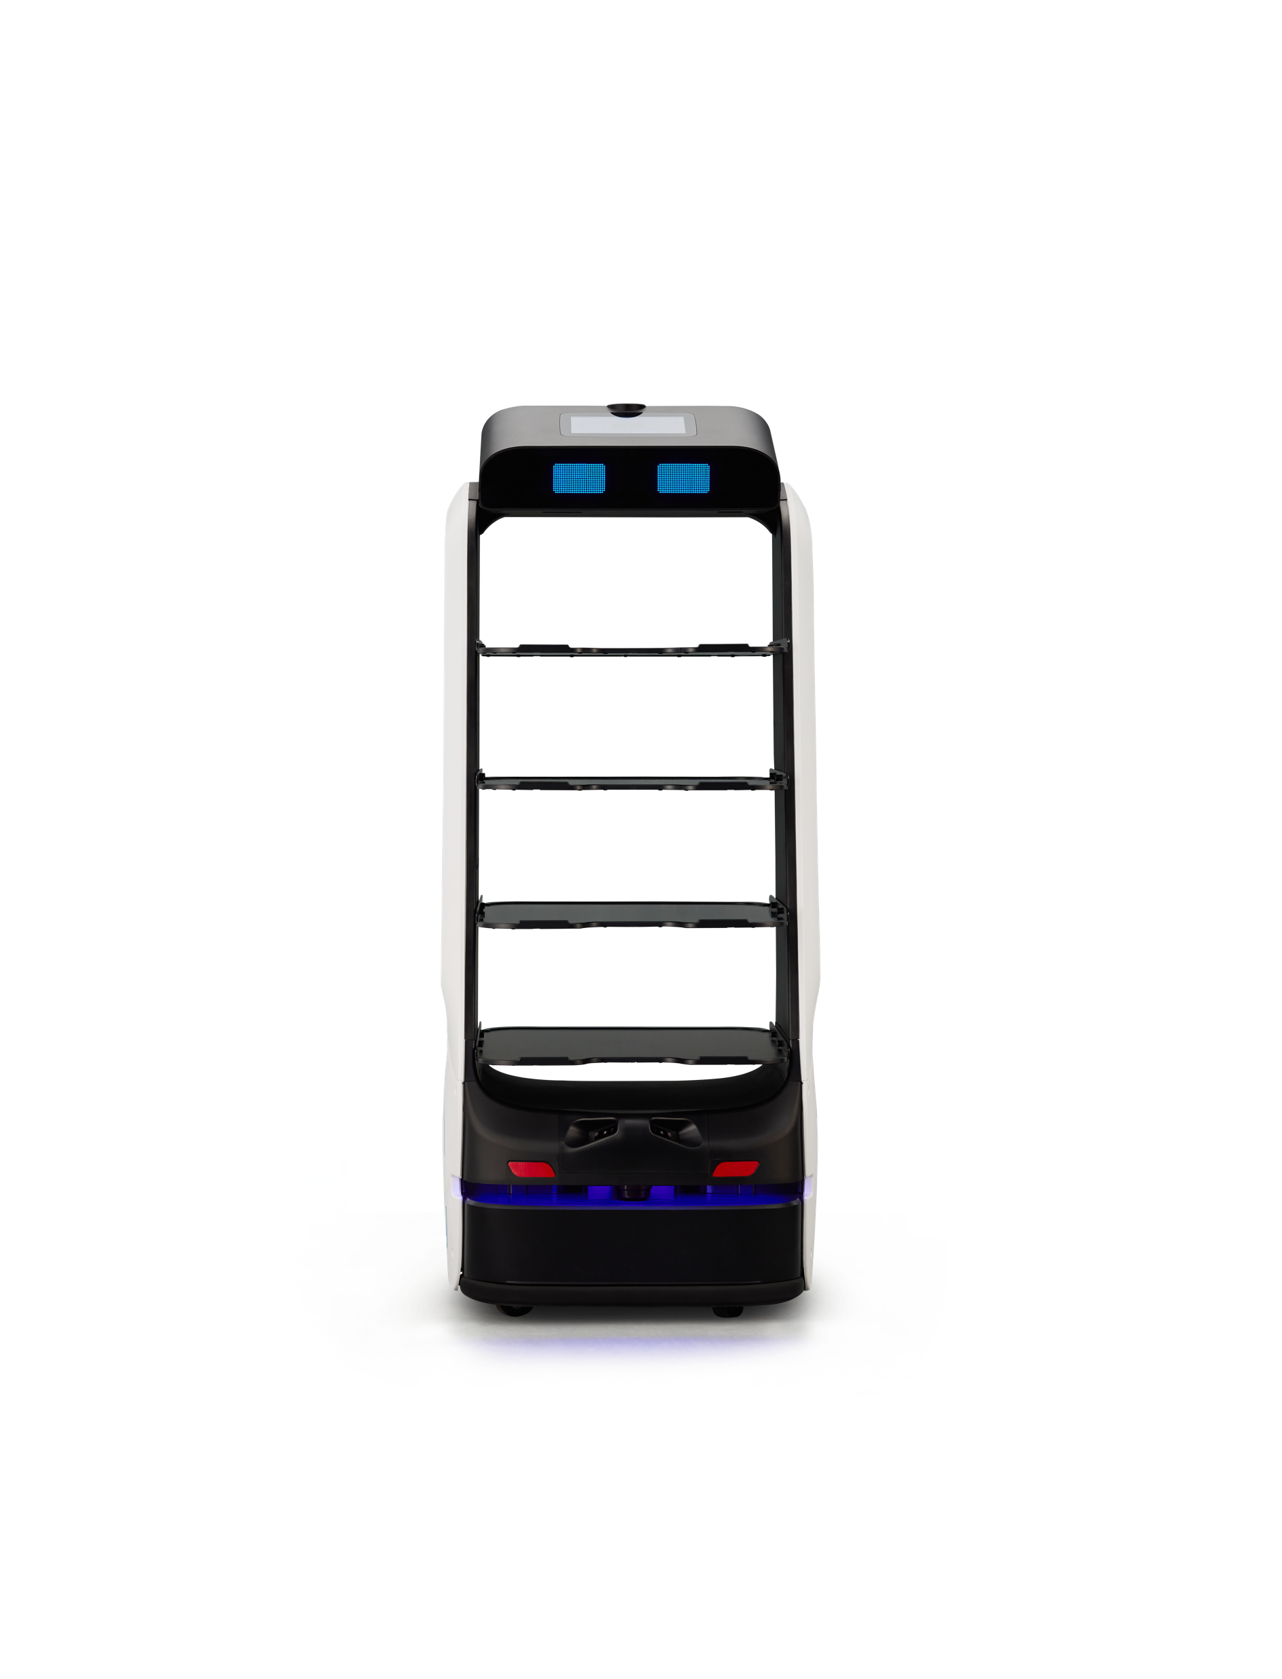


Responsibilities & SLAs
© SoftBank Robotics. All Rights Reserved.
1

Slide 2
Responsibilities - Training
 | SBR | Distributor
Sales Training | SBR to provide Distributor sales training covering : - key product features - main selling arguments - market dynamics and customer pain points - selling vs. competitive offers | Distributor to nominate sales people to participate Participants pass certification test following sales training
Technical Training | SBR to provide technical training on: - basic troubleshooting - issue triage - on-site preventative maintenance | Distributor to nominate resource(s) for technical training Participants pass certification test following technical training
Deployment Training | Organised with Distributor according to business requirements and Distributor volume commitments | Distributor to nominates resource(s) to run deployments Participants pass certification test following deployment training

Slide 3
Responsibilities – Service Availability, Documentation, SW Updates
 | SBR | Distributor
Service Availability | For escalations, business hours are 09:00 to 17:00, M-F (CET) | Business hours, minimum 09:00 to 17:00, M-F For after hours, a messaging service will be actively monitored After-hours response on next business day within 3 hours
End-User Documentation | End-user manuals in English (or another major European language) sent to Distributor in electronic format | If local language not provided by SBR, Distributor will translate manual(s) from English into local language Distributor will print end-user in-box manual and give to end-customer
Software updates | SBR will alert Distributor in advance of software updates For significant updates, SBR will conduct webinars or other sessions to provide more detail | Distributor will update end-user’s robot software according to guidance form SBR

Slide 4
SLAs
 | Process | SBR => Distributor SLAs | Distributor => End-User & SBR SLAs
Software Issues | End-customer contacts Distributor Distributor attempts to resolve issue Distributor escalates to SBR issues that can't be resolved SBR resolves issue, if necessary by escalation to manufacturer | SBR responds to Distributor next business day on status of software issue that was escalated | Distributor's first response to end-user within 3 business hours (if issue raised after hours, on next business day) If required, Distributor escalates to SBR same day via ticketing process
Hardware Issues | End-customer contacts Distributor Distributor attempts to resolve issue Distributor escalates to SBR Technical Network issues that can't be resolved (for SBR Service Pack customers) and technician arrives on site next-business-day to resolve issue Labour and parts are included in onsite repairs (service pack) | For SBR Service Pack customers, SBR Technician Network on site "next business day" for calls received before 2 pm For issues that a technician can't resolve on site, a swap unit will be arranged | Distributor's first response to end-user within 3 business hours (if issue raised after hours, on next business day) If necessary, Distributor escalates to SBR Technician Network same day via phone or online ticket

